Slide 1
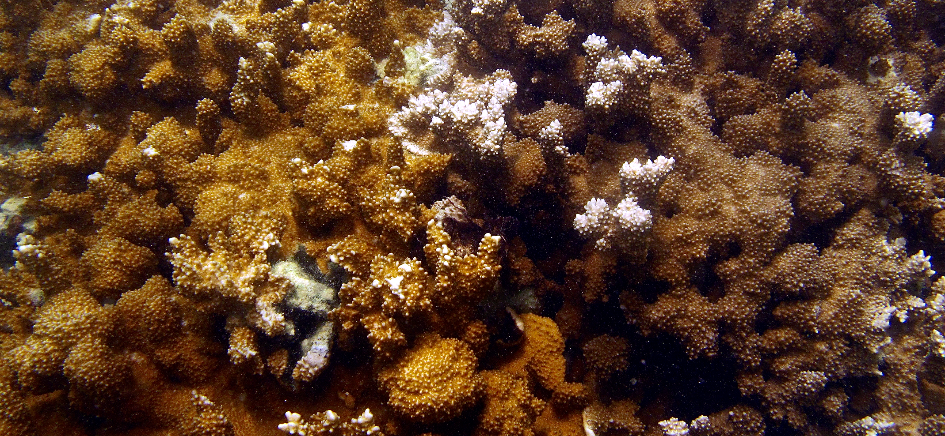
Spatial Distribution of Symbiodinium and Color in Montipora capitata Across Kāne‘ohe Bay, O‘ahu, Hawai‘i
Teegan Innis¹, Ross Cunning², Raphael Ritson-Williams², Chris Wall², Ruth D. Gates²

Slide 2
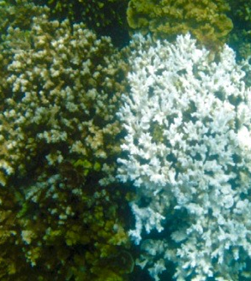
Background
Montipora capitata associates with clades C and D exclusively and in mixtures
Brown and orange color morphs characterize Montipora capitata
Symbiont dominance predicts bleaching susceptibility (Cunning et al. 2016)
Notes:
Functional differences in C and D – C more efficient carbon-delivery to host and D more stress-tolerant
Leveraging Ross’s paper looking at symbiont community differences in bleached colonies – all bleached colonies C, non-bleached colonies C and D, all D nonbleached – what is the distribution of symbionts across the bay?

Slide 3
Questions
What variability exists in the symbiont community composition and color morphologies of M. capitata in Kāne‘ohe Bay?
Is the symbiont community composition different between color morphs?
What environmental parameters are driving the distribution?
Notes:
Mcap associates with C and D, though many corals only associate with 1 clade
Little known about color morphs in Mcap but exists as orange and brown
Environmental scale – each reef, reef type, region of bay, etc.
2 distinct color morphs (brown and orange)

Slide 4
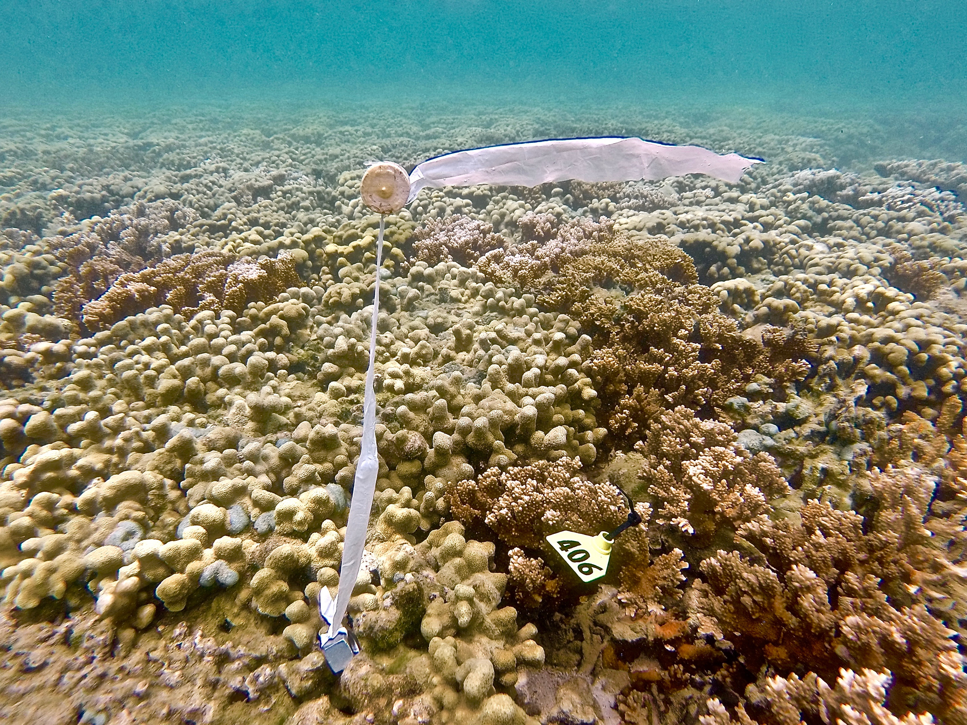
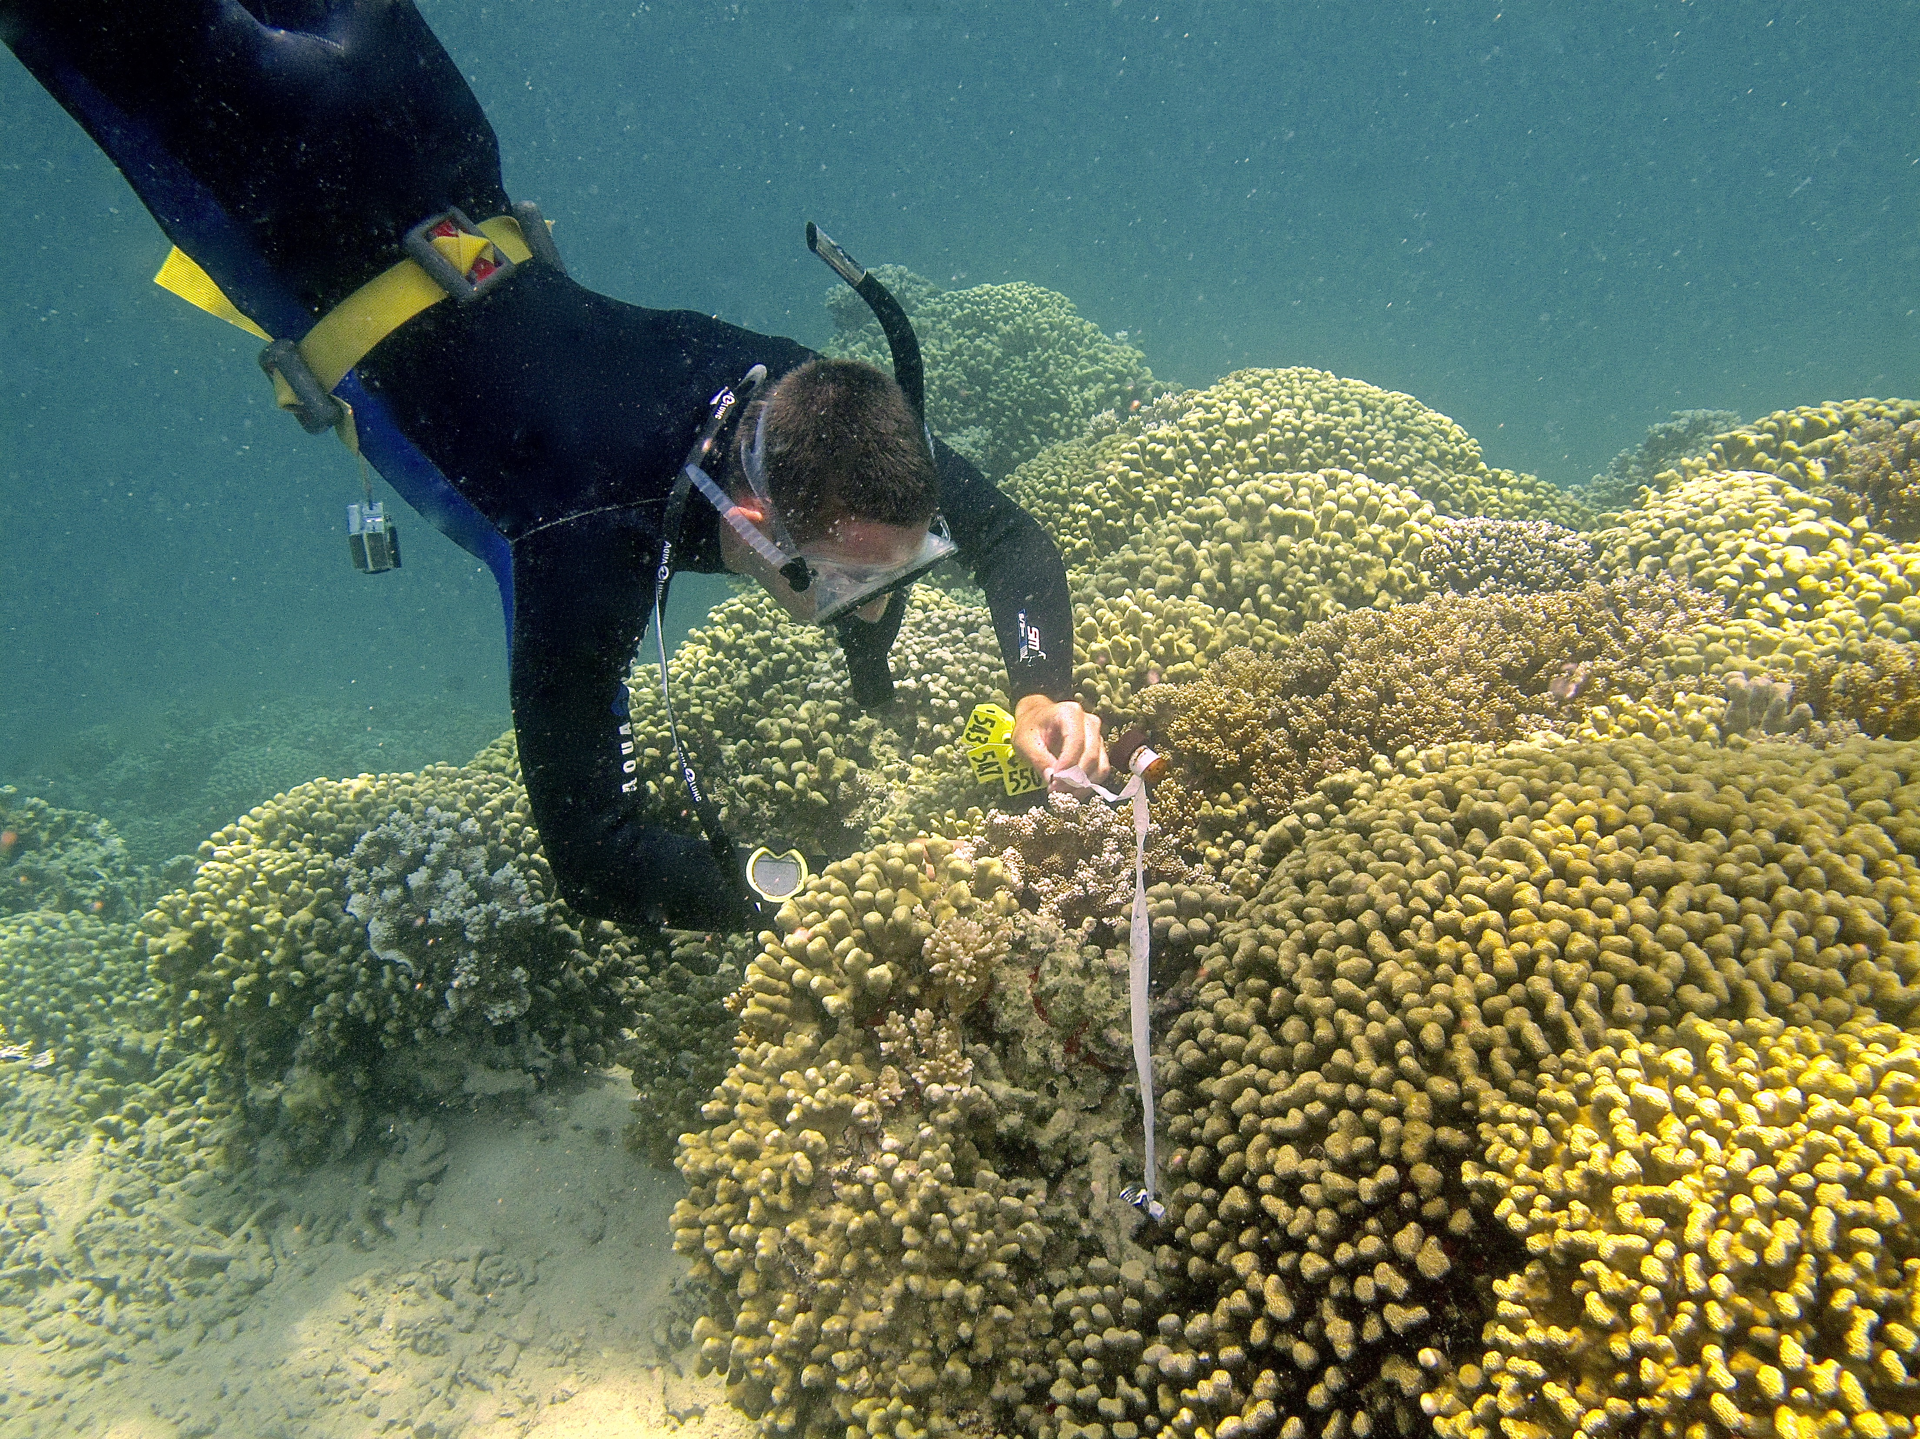
Methods
Tag, sample and photograph colonies in different habitats
Visual assignment of color morph
Quantitative PCR Clade C:D ratio
Notes:
Fragment from top of each colony
Random sampling with use of floats/weights
30 colonies from each patch and 20 from each fringe
Need for more robust technology for color morph assignment – Jennifer working on this?
qPCR looking simply at dominance of C or D and relative ratio of C:D in each colony – host cell not relevant to questions of this study – duplicate reactions (clade in 1 colony not considered present in colony)

Slide 5
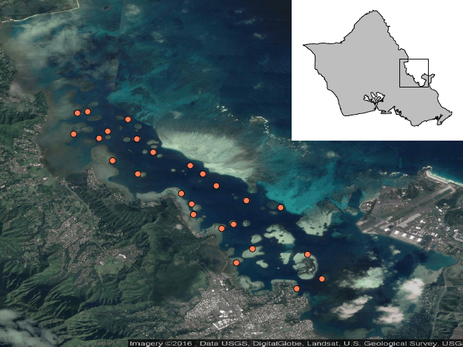
3km
Notes:
16 patch reefs, 9 fringe reefs for a total of 25 sites – 707 total colonies
Different habitats across sites – increasing oceanic influence, residence time differences, proximity to freshwater influence, differences among patch and fringe
Side note: impetus for this project was to have a large sample of tagged corals throughout the bay – all colonies tagged with GPS, color assignment, symbiont composition/dominant symbiont, region of bay, reef type, etc. to be used in future monitoring/analyses – will be making spreadsheet – every colony has biopsy sitting in buffer and fragment archived in -80

Slide 6
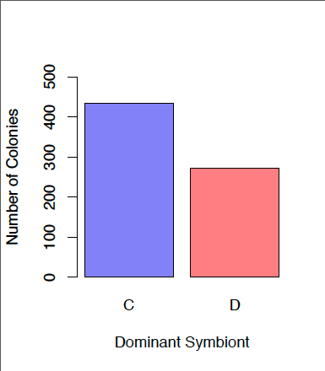
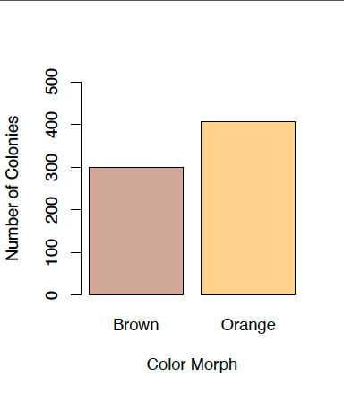
Overall Abundance
Symbiont Clade
Color Morph
n=434
n=407
n=300
n=273

Slide 7
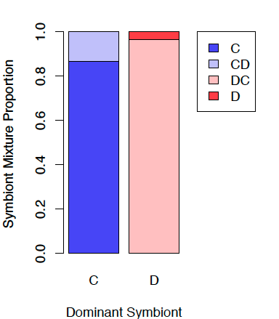
Symbiont Community Composition
n=431
n=276
Of total colonies:
Clade C – 98.7%
Clade D – 46.8%
Notes:
9 colonies D-only – high Ct values (>35 of 40 cycles) even after re-extraction and run through another qPCR and C present in 1 technical replicate in 5 colonies – perhaps D is never exclusive but levels of C association are extremely low?

Slide 8
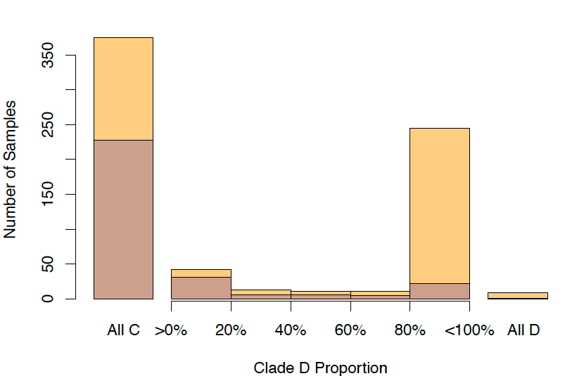
Symbiont Community Composition per Color Morph
Notes:
C dominant in 61% colonies
86.6% C-dominated were exclusively C, 3.3% D-dominated were exclusively D
C-dominance in 89% brown colonies, D-dominance in 59% orange colonies
When D present, typically in abundance >80% indicating D-dominated colony – even mixtures highly dominated by 1 symbiont

Slide 9
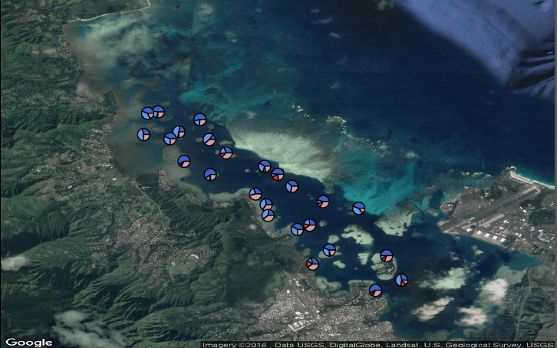
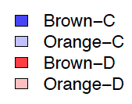
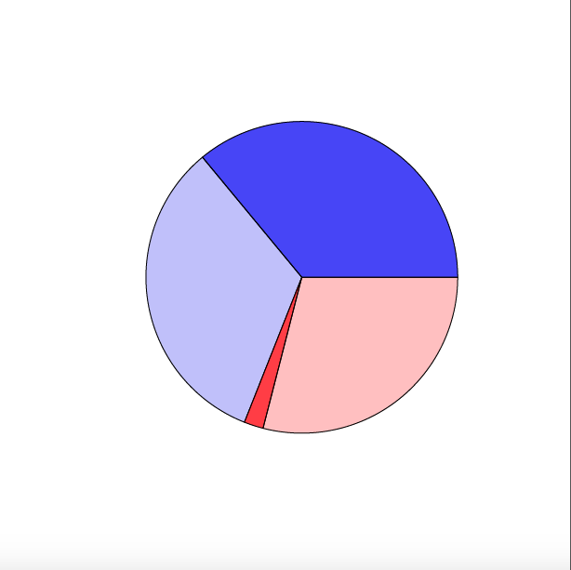
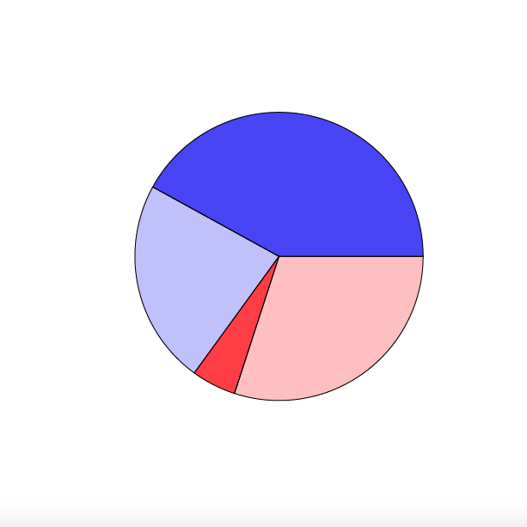
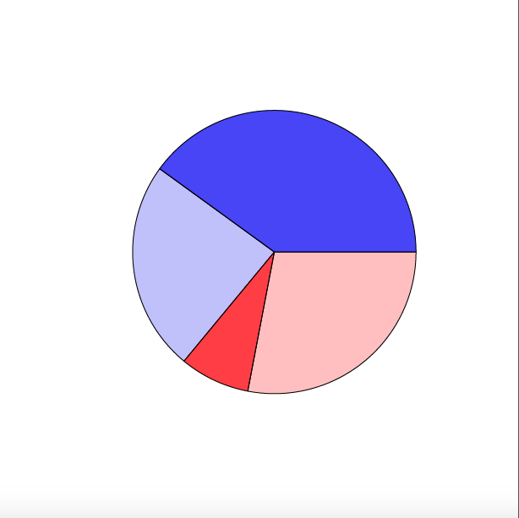
North
Central
South
Notes:
Depth-corrected spatial distributions across the bay
No apparent patterns though reefs closer together appear similar – not statistically with clustering
Only spatial pattern is with color and symbiont across regions, driven by brown colonies with D increasing from north to south – only 33 colonies driving this pattern

Slide 10
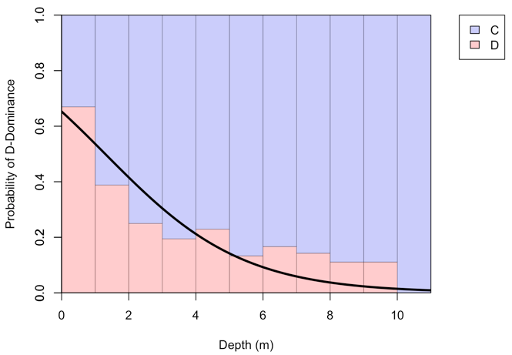
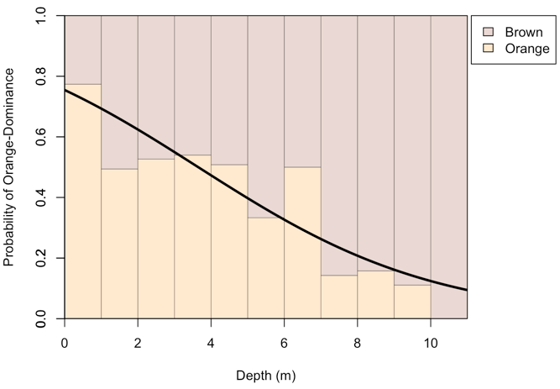
Depth Distributions
Symbiont Dominance
Color Morph
Notes:
bars indicate relative frequency of symbiont dominance when pooling all samples across 1m depth intervals
Line indicates probability of being dominated by D – depth threshold at 1.29 m – did not vary significantly across reefs or regions
Bars indicate relative frequency of color morph dominance when pooling all samples across 1m depth intervals
Line indicates probability of being dominated by orange – depth threshold at 3.64 – did not vary significantly across reefs or regions
Both apparently responding to abiotic conditions variable with depth

Slide 11
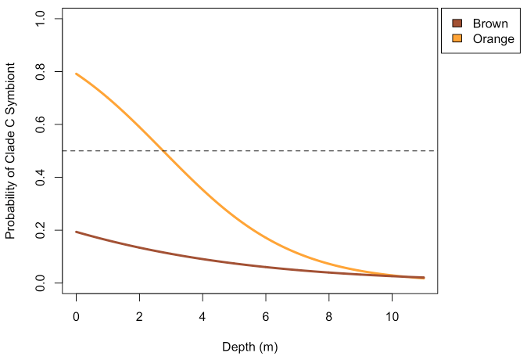
Depth Influence on Dominant Symbiont and Color Morph
*2.75m
p < 0.001
*
Notes:
Again, threshold varies at each individual reef, yet not significantly
Interaction between the 2? – which is the causing agent? – or are both similarly responsive to environmental agents?

Slide 12
Conclusions
Orange, brown, C-, and D-dominated colonies equally prevalent across Kāne‘ohe Bay
Depth drives both symbiont and color morph distributions
Brown colonies C-dominated across depths, orange colonies D-dominated shallow and C-dominated deep
Notes:
Abiotic conditions should be monitored at different depths in addition to the current different reefs
What conditions are the causing agents can then be determined – light attenuation with depth is candidate though temperature, freshwater lensing, etc. are also potential influences

Slide 13
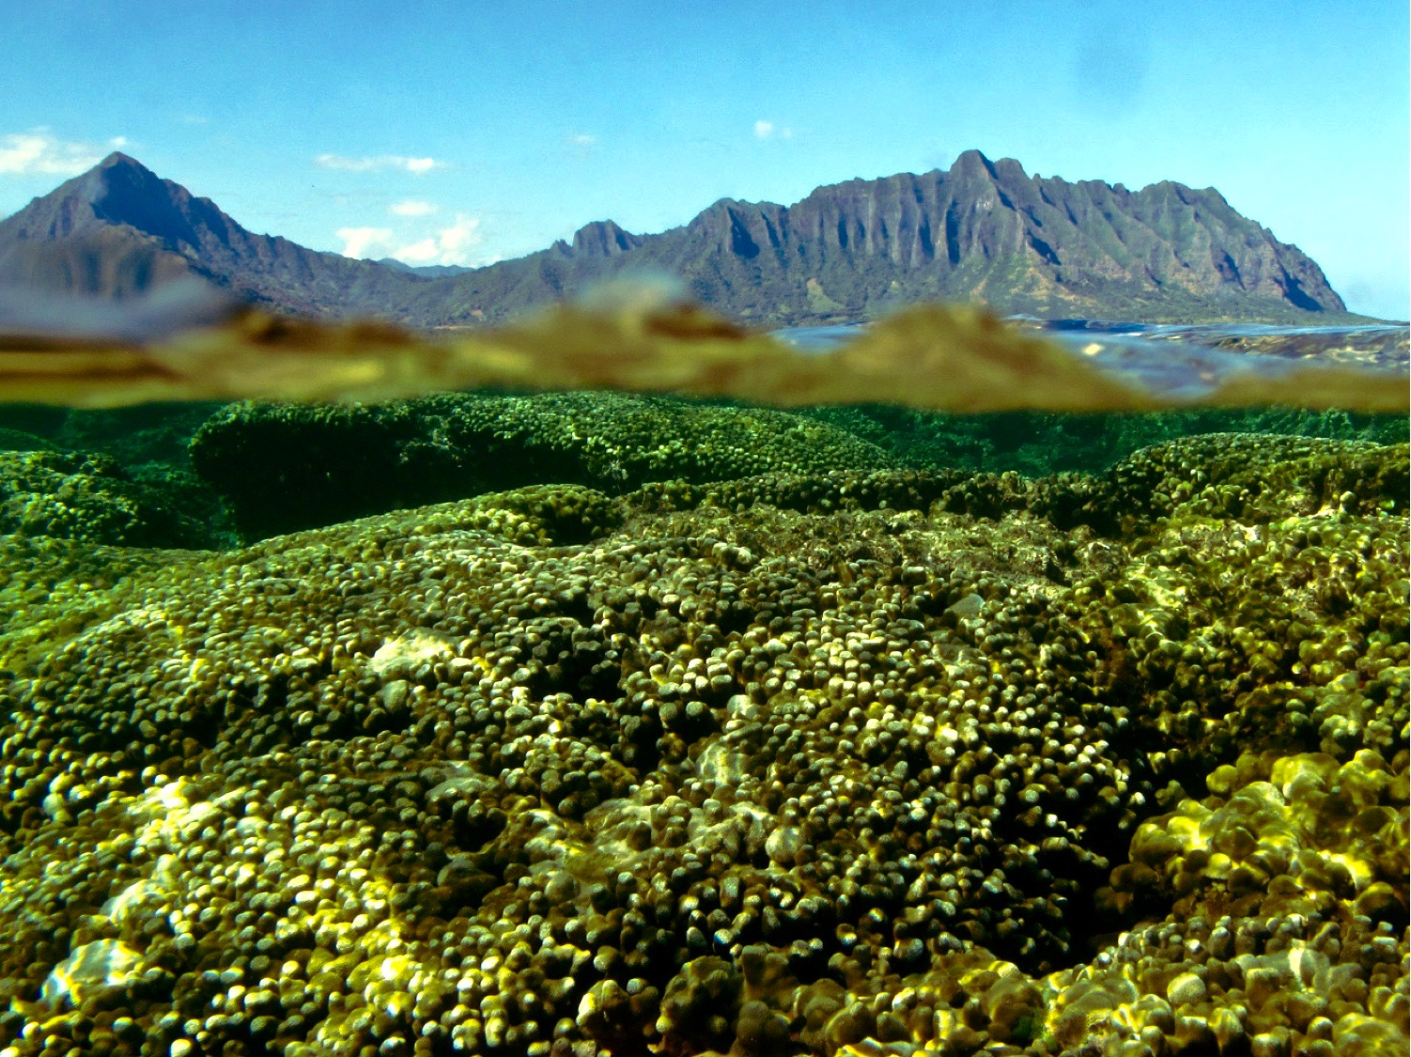
Acknowledgements
Ross Cunning
Raphael Ritson-Williams
Chris Wall
Ruth Gates
Gates Lab
A. Wen
J. Levy
D. Fant
Mark Patterson
Jon Grabowksi
Liz Magee
Northeastern University Three Seas Program

